Slide 1
Analysis of User Behavior for Twitter Posts on Hadoop - Priya Gupta
- Abhilash Saj

Slide 2
Index
Introduction – Big Data, Sources, Hadoop, Sentiment Analysis
Project
Challenges
Existing Work
Proposed Work
Methodology
Conclusion and Future Work

Slide 3
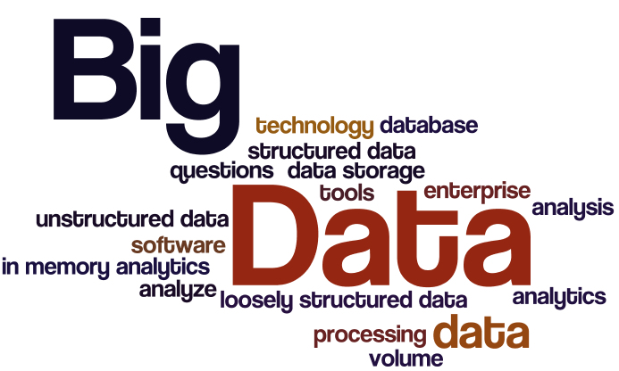
INTRODUCTION – BIG DATA
Collection of large datasets
Structured and unstructured data
Difficult to process and analyze

Slide 4
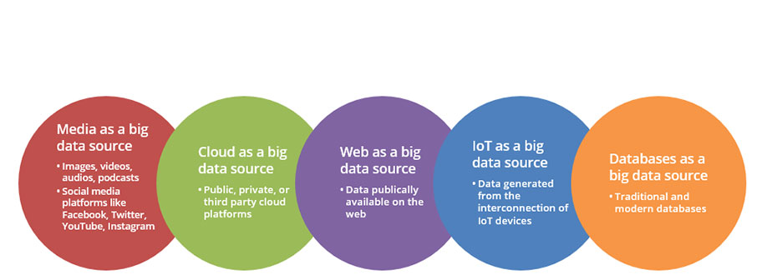
SOURCES OF BIG DATA

Slide 5
Hadoop
Hadoop is a flexible and open source implementation for analyzing large datasets using MapReduce.
There are various emerging technologies such as Apache Pig, Hive, Sqoop, HBase, Zookeeper, and Flume that can be used to improve the performance of basic Hadoop MapReduce framework.

Slide 6
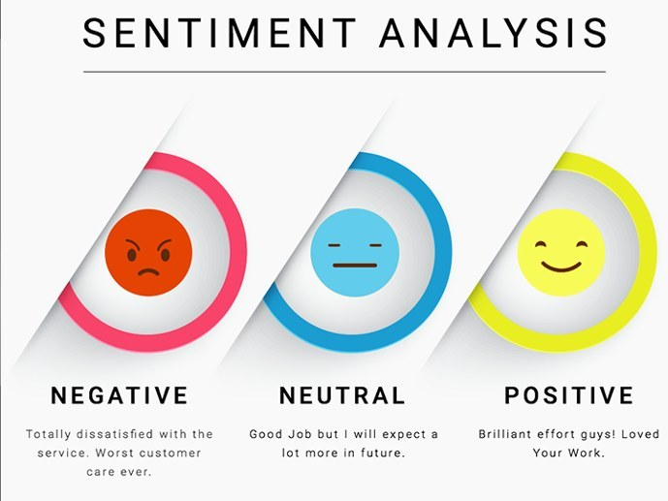

Slide 7
Project
Tweet analysis for user behavior.
Tweets are available in JSON format which is to be converted into a structured data.
Output how users behave for particular topic in certain country and city.

Slide 8
Challenges with social media data
Grammar and Spellings
Trustworthiness
Format
Language

Slide 9
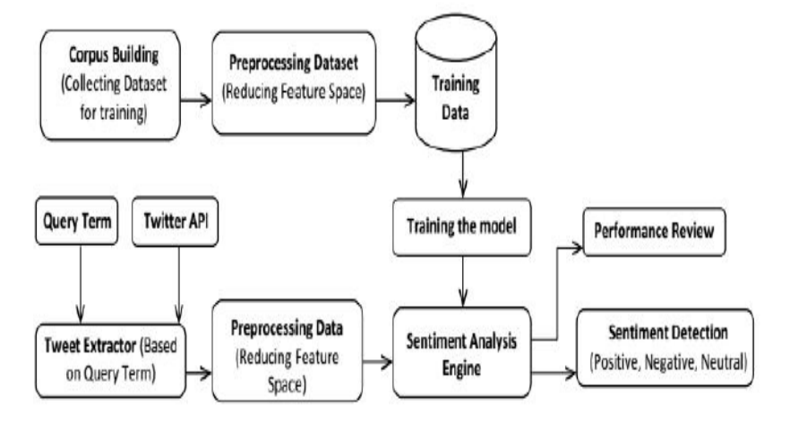
Existing Work

Slide 10
Explanation
Firstly, training data collected from various sources is subjected to preprocessing to eliminate features which do not contribute to polarity detection.
This training data is fed into sentiment analysis engine for classifying test data.
Secondly, the input query term is used to fetch data from social media for which polarity is to be detected.
The sentiment analysis engine contains Naive Bayes classification algorithm which consults training data to calculate probabilities and predict the sentiment for given query term.
Demerits with existing system are that it is only used for sentiment analysis of uses i.e. positive, negative or neutral.

Slide 11
Proposed system
The proposed system focuses on the behavioral of user according to various tweets that whether the user is in drifting mode, positive, or negative.
Also the proposed system focuses on the general behavior of user country wise or city wise in context of particular topic.

Slide 12
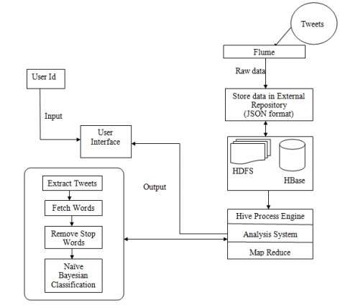

Slide 13
Methodology
Connected to live social media to extract and store data using flume.
Secondly, Data is stored in external repository. Then, convert the JSON tweet data to .CSV file and transfer it to HDFS.
After that, create table in Hadoop using hive to give data a tabular form.
Then, do user behaviour analysis on tweets by extracting past few tweets of particular user corresponding to tweet_id.
Create codes for providing visualization of user behaviour.
Lastly, Using naïve Bayesian technique and map reduce to apply the analytics on tweet.

Slide 14
Steps
Creating Twitter Application
API Key, API secret, Access token and Access Token Secret.
Extraction of data via Flume
Convert data into .csv format and upload to HDFS.
Run Hive script and create table
Pre-processing of data
USERNAME, Links,’#’, stopwords, punctuations are removed.
Convert tweets to lower case characters to remove unevenness.
Classification using Naïve Bayesian technique
Visualization

Slide 15
Conclusion
We can identify the user behaviour with the help of user_id whether the user is positive, negative or in drifting mode.
The system tells general behavior of users country-wise, city-wise for a particular topic.
The system is 70-80% accurate.

Slide 16
Future Work
The data can be from multiple sources at the same time.
Tools like R, tablue can be integrated.
Further works can be done to improve the efficiency and accuracy.

Slide 17
Thank You.

